Slide 1

Department of Computer Science and Business Systems
Course name /Course code: Innovative multidisciplinary Project, Project with Design Thinking & Final Year Project
Title of the project :Estimatrix-Predicting project cost and Timeline

Slide 2
Class / Section / Semester | : | III-CSBS -VI
Batch | : | 2023-2027
Project Review | : | Second Review
Date | :
Project Guide with Designation | : | Dr.K.Cholaraja
Name of the Industry ( if applicable) | : | IT Industry
Team Members | : | Adriannaa Anand Dharshini Vaishnav Aravindh

Slide 3

CHALLENGE STATEMENT
In software development and engineering industries, inaccurate estimation of project cost and completion time leads to:
Budget overruns
Project delays
Resource Mismanagement
Client dissatisfaction
Financial loss
Traditional estimation methods such as expert judgment, manual calculation, and fixed models (COCOMO) often fail to handle complex and dynamic project environments.

Slide 4
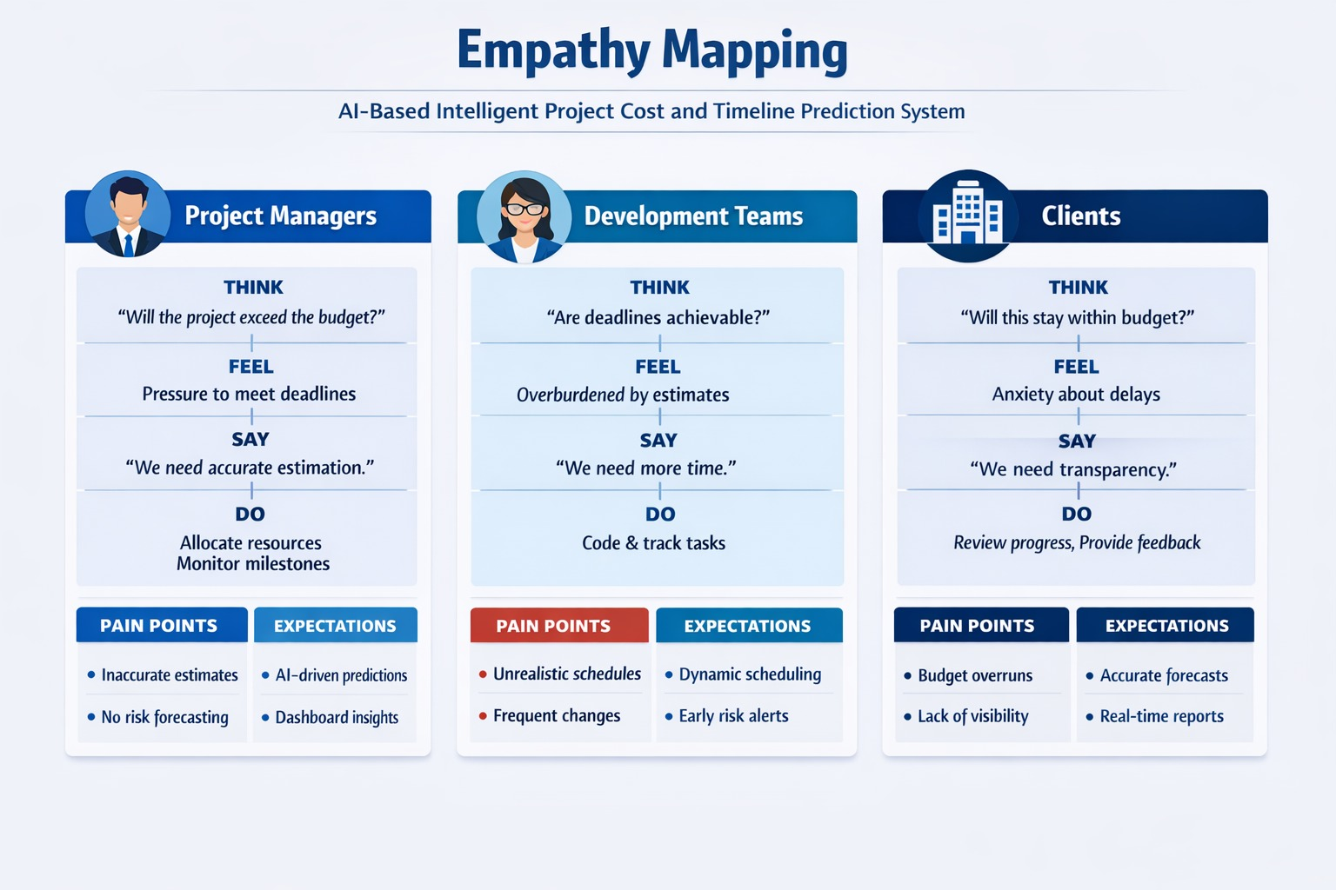
EMPATHY MAPPING

Slide 5
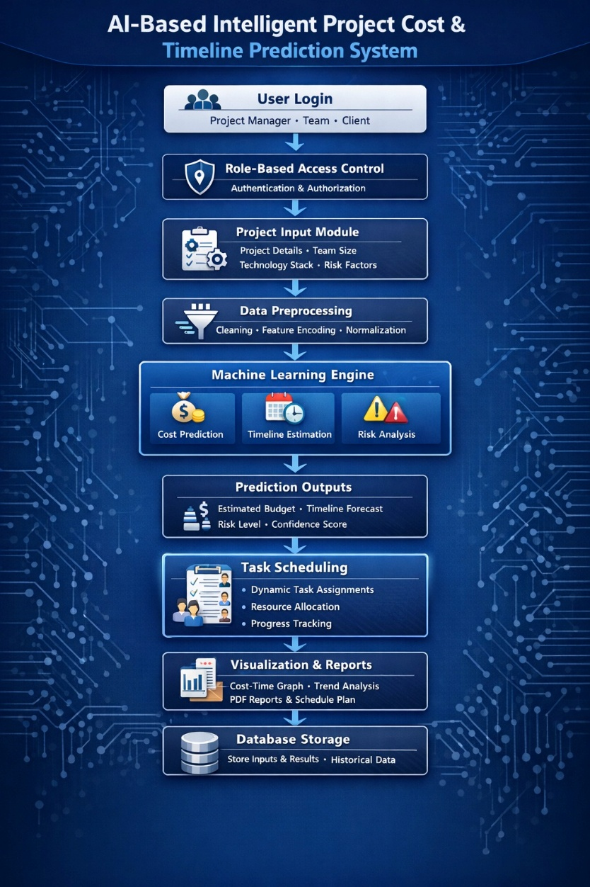
CONCEPT / SCOPE OF SOLUTION
To design and develop an AI-powered predictive system that:
Predicts project cost using regression models
Predicts project duration using ML algorithms
Identifies risk probability using classification models
Provides explainable AI insightsSupports

Slide 6
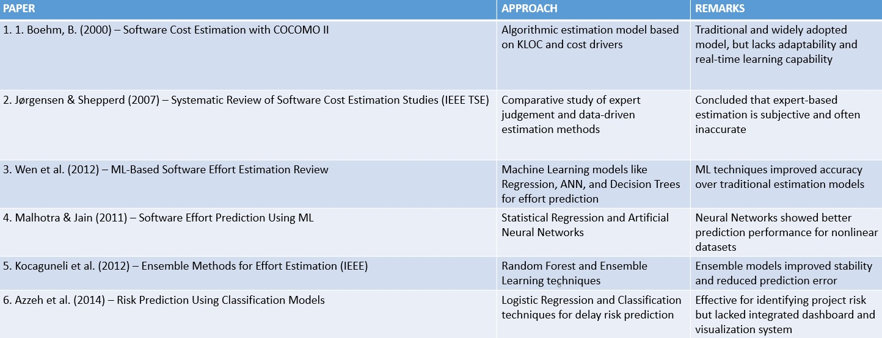
LITERATURE SURVEY / BACKGROUND STUDY
PAPER | APPROACH | REMARKS
1.
2.
3.
5.
6.
Minimum 6 papers

Slide 7
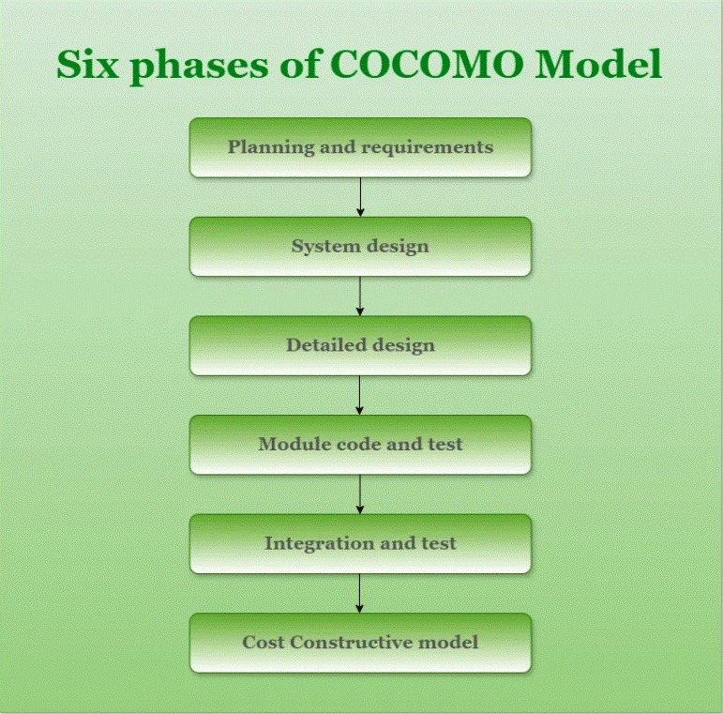
EXISTING METHOD
Expert Judgment-Based Estimation
Traditional Algorithmic Models (COCOMO)
Agile Estimation Techniques
Manual Scheduling Tools

Slide 8

PROPOSED / INNOVATIVE METHOD
AI prediction of project cost and timeline
Risk detection using machine learning
Automatic schedule updates
Past project comparison for better prediction
Dashboard for cost and time visualization
Role-based access (Manager, Developer, Client)
Explainable AI for prediction reasons
Automatic report generation

Slide 9
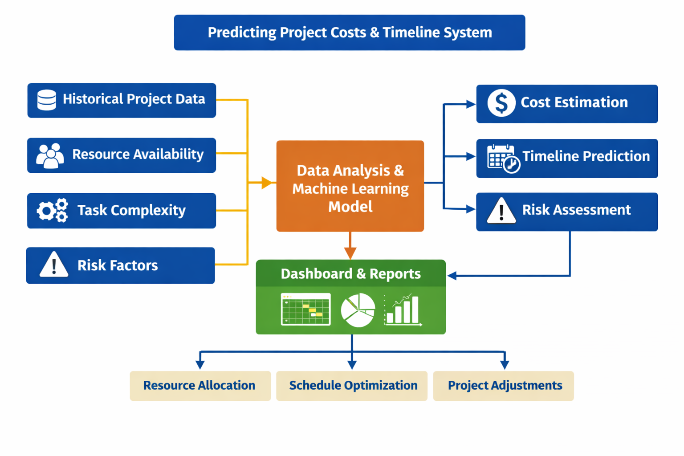
BLOCK / SCHEMATIC DIAGRAM

Slide 10
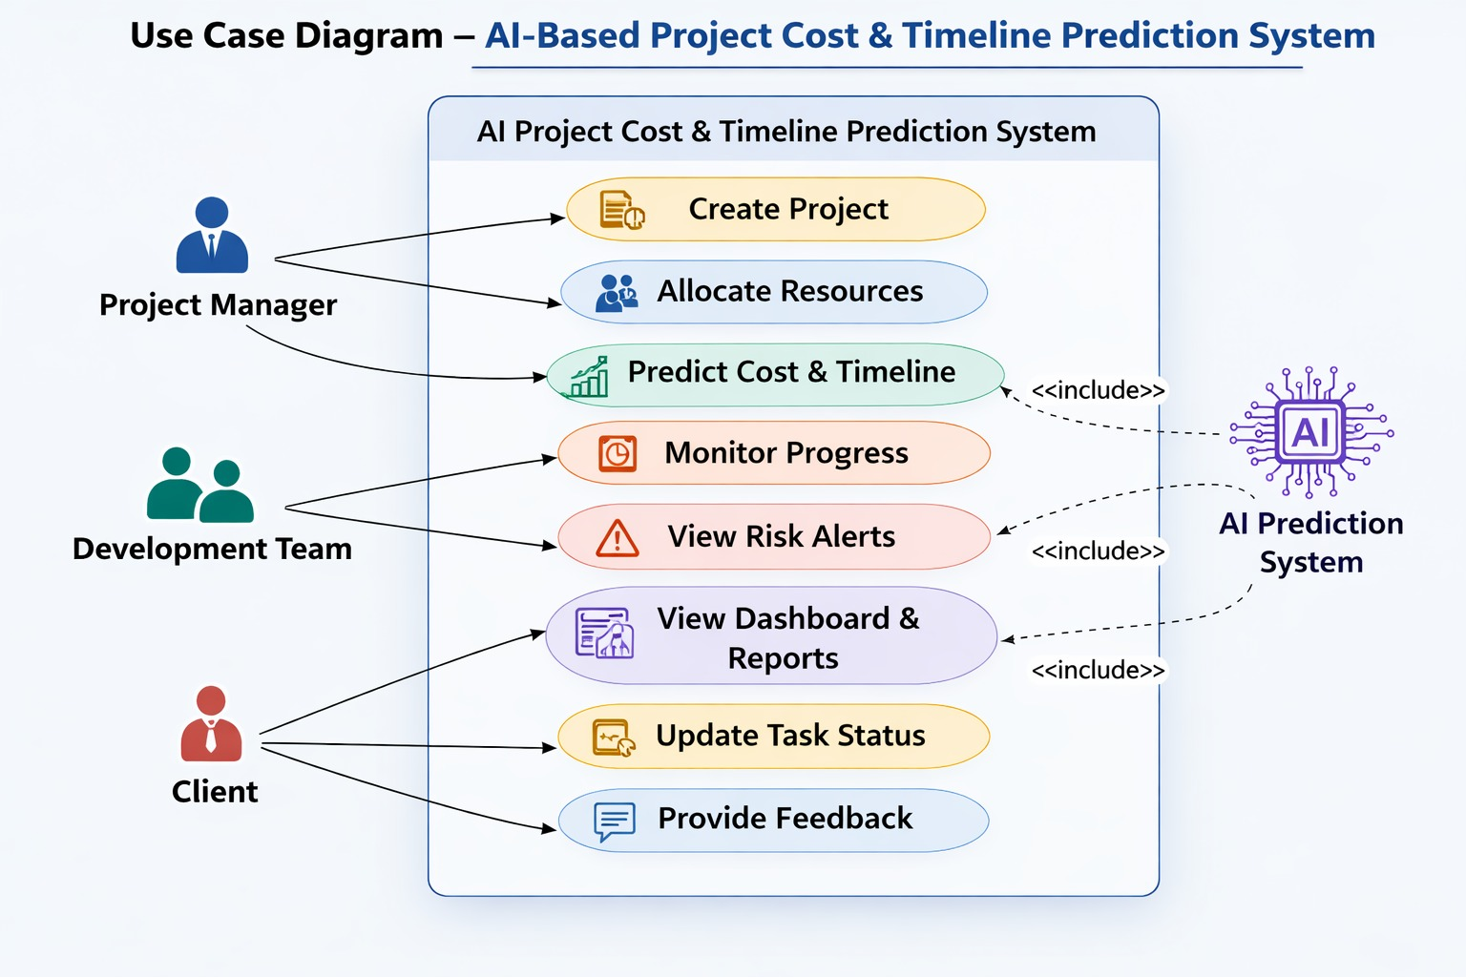
USE CASE DIAGRAM

Slide 11
TECHNOLOGY USED
Backend Development
Python Flask / FastAPI RESTful APIs
Frontend Development
React.js
HTML
CSS
JavaScript
Database & Authentication
Firebase Firestore (Cloud NoSQL Database
Data Visualization Chart.js Matplotlib (Model Evaluation) & Artificial Intelligence & Machine Learning
Linear Regression Random Forest XGBoost
🌐 Cloud & Deployment Firebase Hosting Amazon Web Services (Optional for ML Deployment)

Slide 12
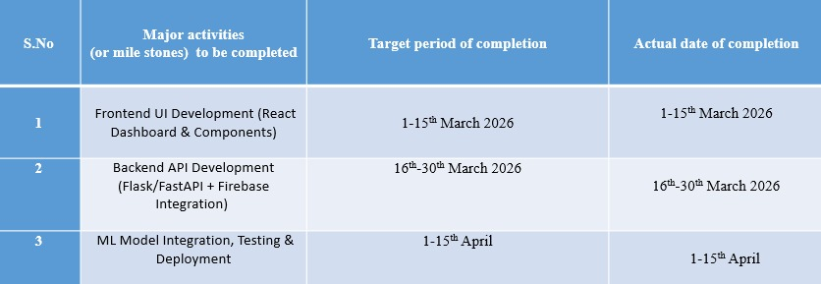
Action Plan
S.No | Major activities (or mile stones) to be completed | Target period of completion | Actual date of completion
1 |  | February 2025
2 |  | March 202
3 |  | April 2025
4 |  | May 2025

Slide 13
CONCLUSION
The Project Cost and Timeline Prediction System uses data analytics and machine learning to estimate project duration and budget based on historical data, resources, and task complexity. It supports better planning, efficient resource allocation, and progress visualization, helping organizations reduce delays, control costs, and complete projects on time.

Slide 14
THANK YOU

